Slide 1
Bug Tracking System
Batch: WFS - Hyd (Team 8)
Team Name: Game of Bugs
TEAM MEMBERS
Anjali Varkuti Rutvik Shiyaniya
Preeti Singh Saahil Sharma
Priya Ratnaparkhe Shaik Sana
Rohit Kumar Rai Shivam Kotnala
Sindhu N Pujar

Slide 2
CONTENTS
Members Contribution
Application Features and Project Outline
UI Snapshots
Highlights of Learning

Slide 3
MEMBERS CONTRIBUTION
Sindhu N Pujar - Implemented the base structure of the database as per the functionality requirement of the project. This was followed by the debugging process of different modules and their integration to form the main system.
Anjali Varkuti - Implemented the core design of front-end module as per the functionality requirement of the project and also worked on improving error handling in registration and user process modules.
Shaik Sana - Implemented the design pattern of the front end functionalities as per the functionality requirement of the project and also worked on improving error handling in registration and user process modules..
Priya Ratnaparkhe - Implemented the core functionality of frontend using the JavaScript as per the functionality requirement of the project ,also implemented the class diagram.
Rutvik Shiyaniya - Implemented the bean classes, display all projects and display all bugs functionalities for the project and also did the project cleaning for better presentation.
Shivam Kotnala - Implemented the User registration process module for the project. Also, worked on developing the DFD diagrams for the project.
Preeti Singh - Implemented the functionalities for tester section of the project, and also designed the import user and register user.
Rohit Kumar Rai - Implemented the functionalities of the project manager module, worked on improving error handling in user process modules.
Saahil Sharma - Implemented the architecture design of all the tables i.e designed ER diagrams for better understanding of different tables along with Test Cases.

Slide 4
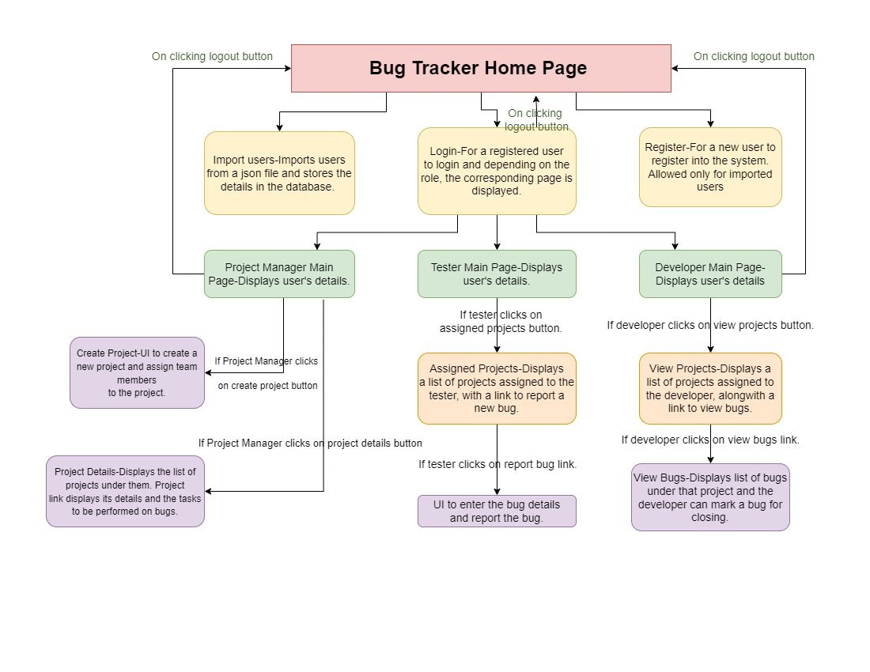
PROJECT
OUTLINE

Slide 5


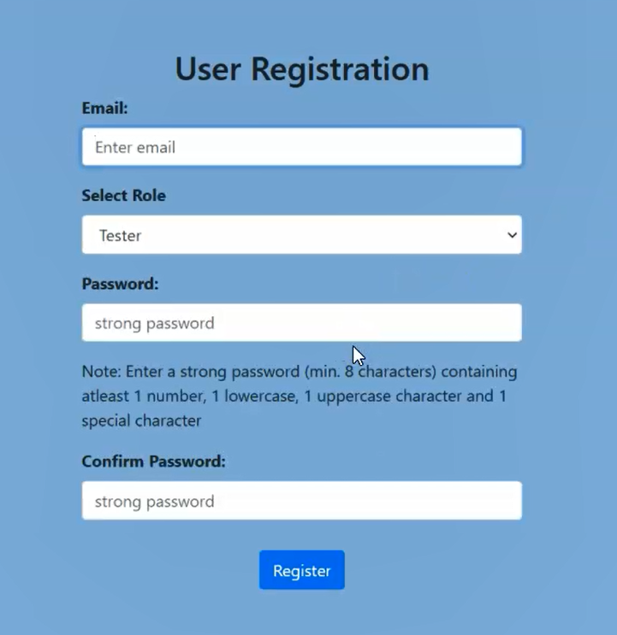
UI SNAPSHOTS
Homepage
User login page
New user registration page

Slide 6
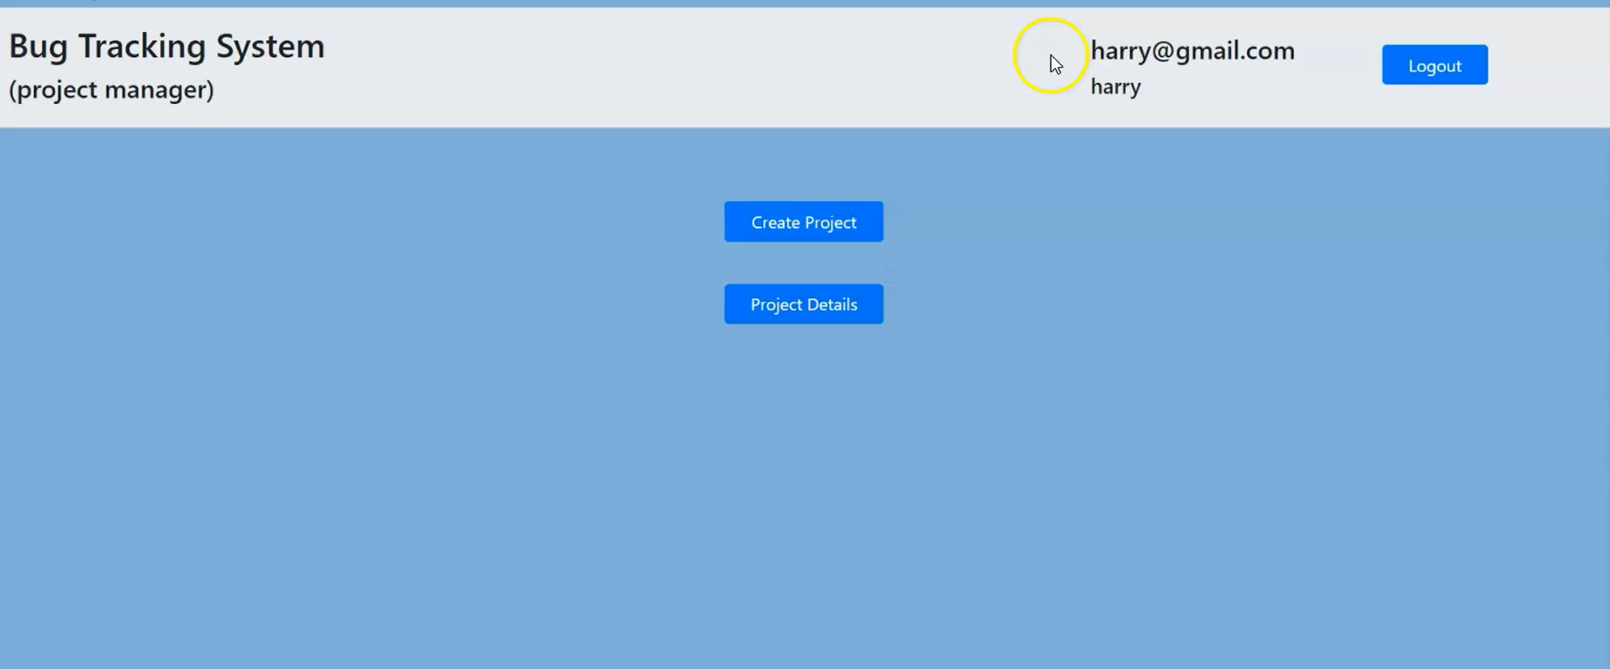
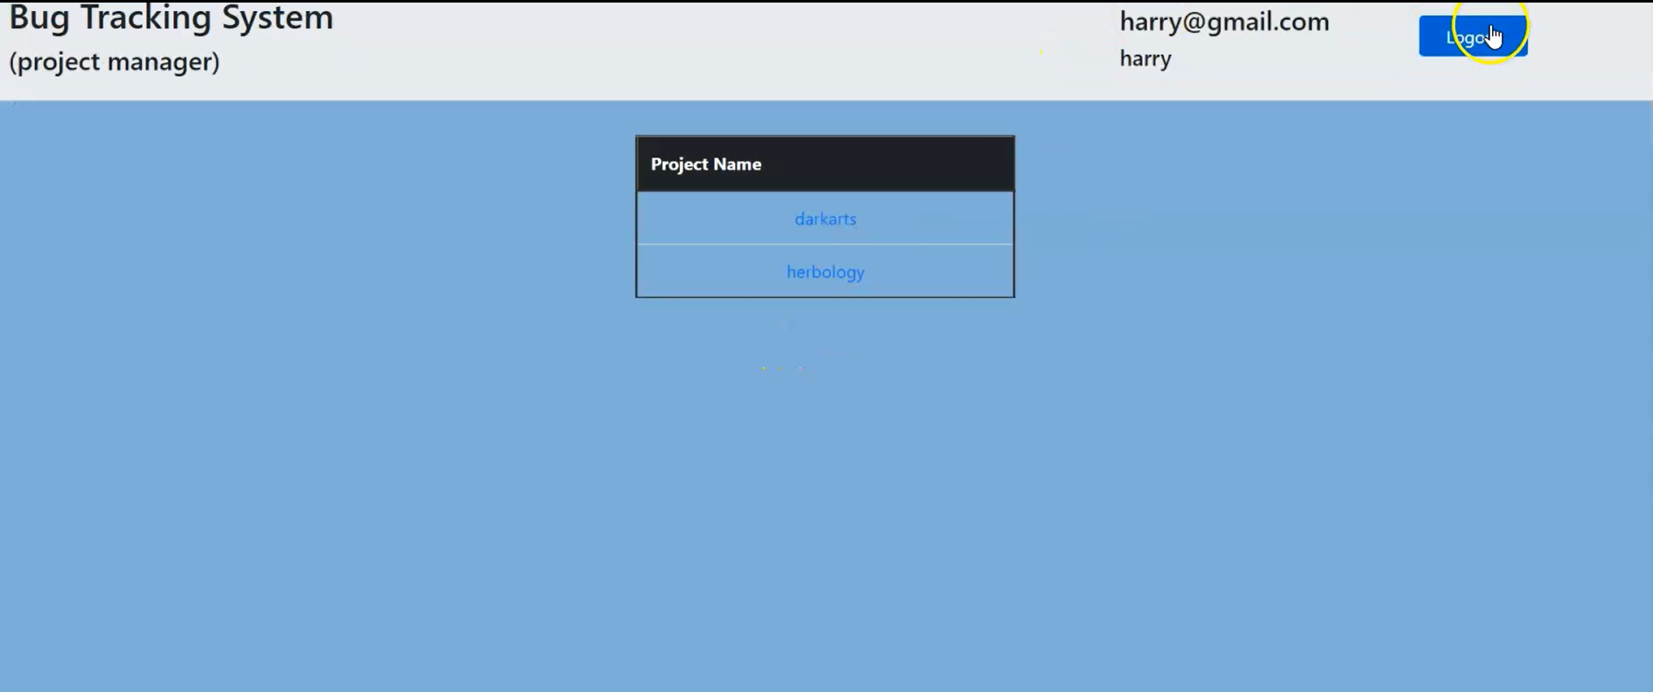
List of projects under project manager

Slide 7
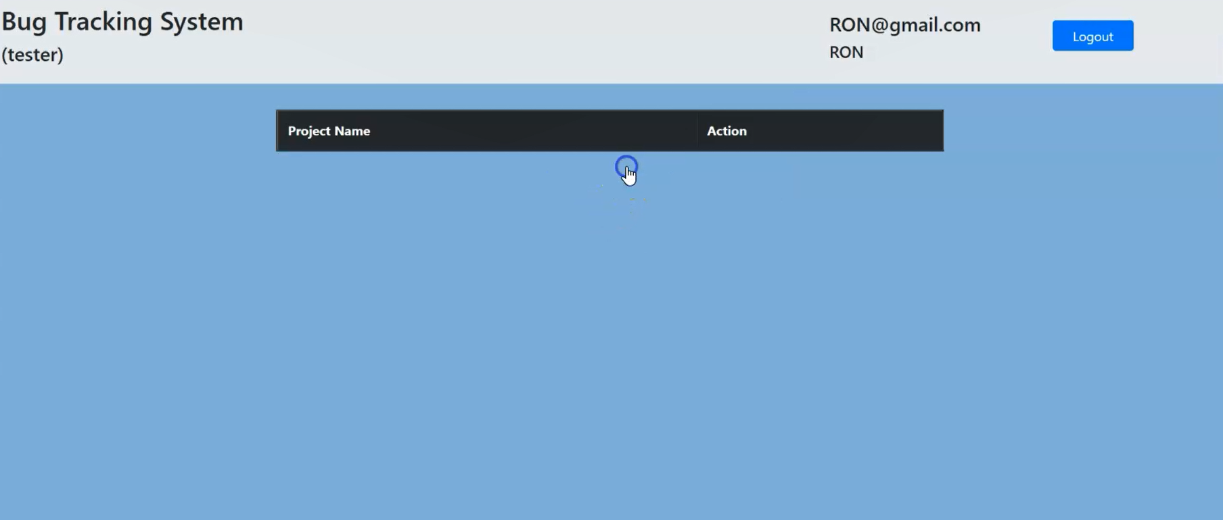
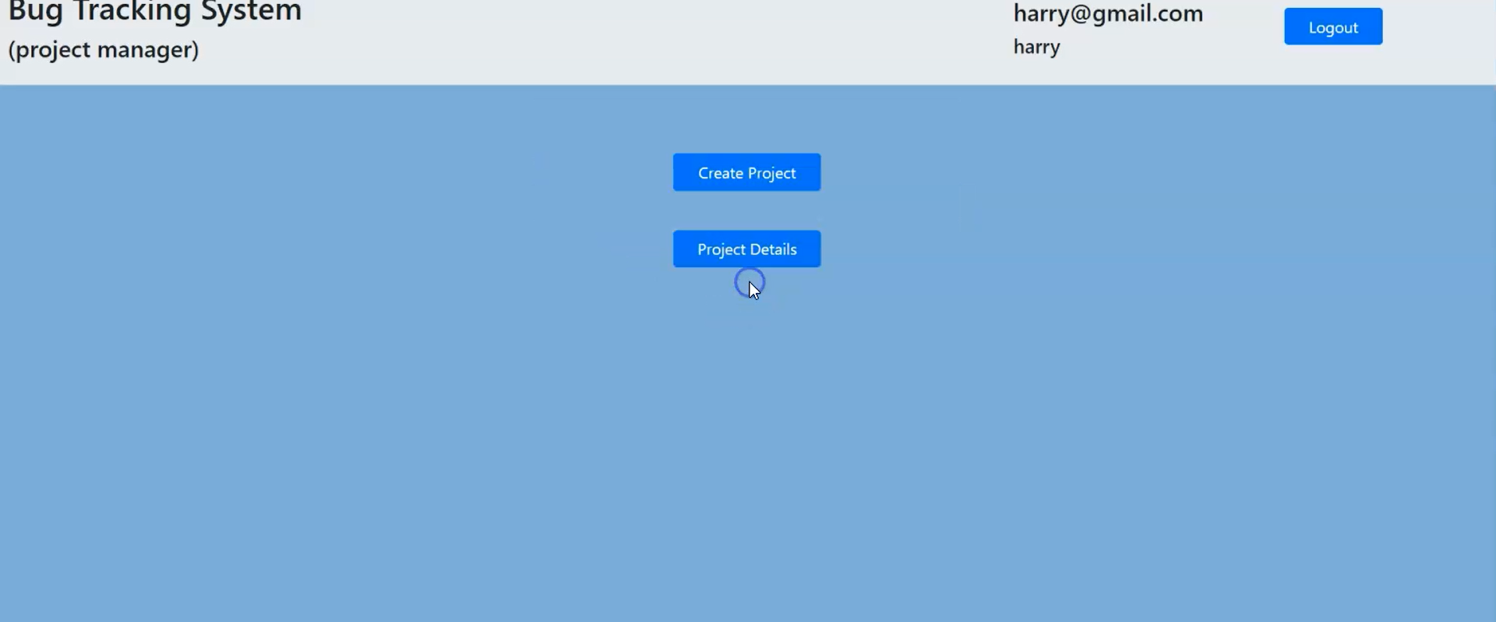
Tester Home Page
Project Manager Home Page

Slide 8
HIGHLIGHTS OF LEARNING
Sindhu N Pujar – Understood the importance of following standards and 3-tier architecture while working on the projects. By trying my hands-on the concepts learnt during my training session I was able to code better understand the tools, project flow and the need of layered architecture and collaboration with every part of the project is necessary,
Rutvik Shiyaniya - Throughout the debugging phase, I learnt different styles of handling the same issue. Along with the understanding of the workflow of the application, I understood the importance of teamwork as well.
Shivam Kotnala- I learnt a lot about GitHub and also got a better understanding of the structure and flow of the project. I also realized the importance of teamwork and collaboration while working on the project.
Preeti Singh - The project enabled me to brush up my skills in web development technologies and I also understood the importance of 3-tier architecture and also the importance of teamwork to solve problems.
Anjali Varkuti - Throughout the project, I learnt methods of error handling and the importance of writing robust code and the 3-tier architecture. I also learnt about soft skills like collaboration, problem solving etc.
Shaik Sana - I learnt the needs and design of layered architecture and loose coupling in an application. Collaborative approach lead to different and unique ideas which helped in creating optimal solution.
Priya Ratnaparkhe - Working on this project gave me exposure of various web application development concepts including but not limited to the implementation of JSP and JS. This project helped me in understanding the importance of teamwork and team coordination. The concepts learned during the bootcamp played a really important role in understanding and building the necessary front end functionalities.
Rohit Kumar Rai - Working on this project gave me a great understanding of the concepts of web applications developer kits such as Servlets, JSPs and there deployment procedures. The training program played a great role in understanding of the deployment procedures.
Saahil Sharma - I have learnt how web applications work and also how to work with json data.

Slide 9
THANK YOU

